Slide 1
Video Game Analysis & Technical Design
Ch.1 History of Video Games

Slide 2


Which game made more $$ in 2011?
VS.

Slide 3
Which game made more $$ in 2011?
Rovio (creator of Angry Birds) announced revenue of $106 million (across all of their games) in 2011
CoD MW3 made $1 billion in the first 16 days it was on the market. It was the first game to do so, and now that is the AAA standard.
The difference is that CoD MW3 took 400 people almost 2 years to make, whereas Angry Birds took 8 people 7 months to create. Which one is more lucrative from a per-person standpoint?
Which leads us to our next point…….

Slide 4
The Game Industry Today
The game industry is incredibly varied today
AAA = the big game studios (big graphics)
Indie = the non-big game studios (mobile, PC, weird, etc.)
Canada has the 3rd largest game industry in the world, and the GTA has the largest indie game community in the world.

Slide 5
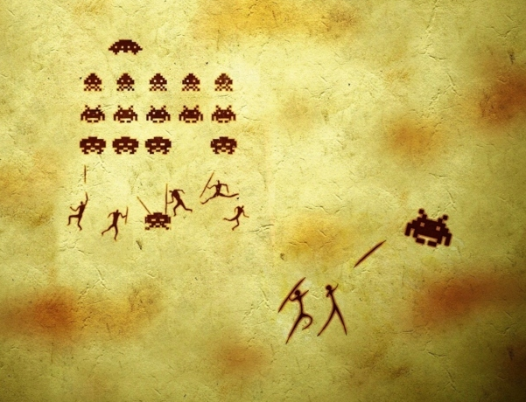
A brief history of time video games

Slide 6
A brief history of time video games
As soon as any new technology is developed, it’s just a matter of time before people start playing games on it……
They started in computer labs, but nobody knew about it
The home console came next, but nobody knew about it
The arcade game came next and popularized video games worldwide!

Slide 7
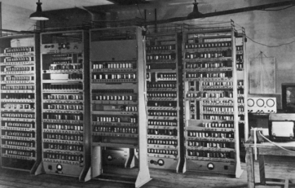

They started in computer labs, but nobody knew about it
1952: Computer playing Noughts & Crosses (Tic-tac-toe) in the UK
1958 Playing Tennis for Two on an oscilloscope at Brookhaven National Laboratory (made for visitors by William Higinbotham)

Slide 8
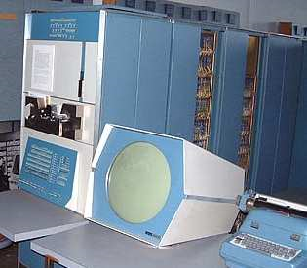
They started in computer labs, but nobody knew about it
Scary thought: What if Higinbotham patented his invention?
US Government would own the patent on video games
1962: Spacewar on a PDP-1 at MIT
Like Asteroids, but two ships shoot at each other

Slide 9
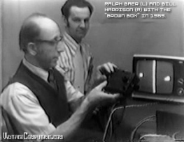
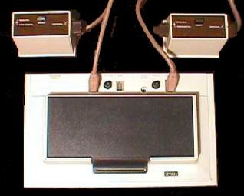
The home console came next, but nobody knew about it
Ralph Baer started making simple TV games in 1966
Eventually released the first console in 1972 (Magnavox Odyssey)
Several Pong-like games that all sucked

Slide 10

The arcade game came next and popularized video games worldwide!
Nolan Bushnell created a cheaper version of Spacewar called Computer Space that took quarters
It was manufacturered by Nutting Associates and “engineered by Syzygy (Nolan’s company he founded with Ted Dabney)
It was released in 1971, and it flopped….

Slide 11
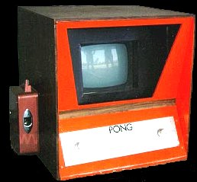
The arcade game came next and popularized video games worldwide!
So Nolan:
Ditches Nuttings Associates,
Forms a new company called Atari (Japanese for “prepare to get your ass kicked”),
And tries again with a game “a drunk could play” called Pong in 1972
Pong is an instant hit, home versions are released in the mid 70s
Ralph Baer & Magnavox sue (and win a small settlement)

Slide 12
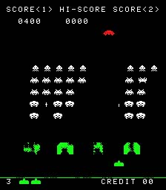
What happened after this?
Space Invaders hit the scene in 1978 and popularized video games worldwide
Called the “greatest video game of all time” by most places such as Guiness
CPU-driven = FUTURE!

Slide 13
What happened after this?
After Space Invaders, everyone and their mother started making arcade games
Nintendo (a playing card company from 1889 that just started making home Pong clones)
Donkey Kong & Mario Bros (by Shigeru Miyamoto)
SEGA (Service Games) - a company in Hawaii that shipped electro mechanical (EM) games to Japan
Frogger, Zaxxon, Golden Axe
Williams – a pinball company in Chicago
Robotron 2084, Defender, Joust
Bally/Midway – another US pinball/arcade company
Pac-man, Galaga, Tron, etc. (mostly made by Namco)

Slide 14
What happened after this?
Video games become part of pop culture in the late 1970s / early 1980s
Space Invaders (https://www.youtube.com/watch?v=Q-9CkkoISYw)
Pac-man Fever (https://www.youtube.com/watch?v=kEGSFk-vCqU)
Lunchboxes, cereal, TV shows (Starcade, Pac-man TV series, etc.), books, movies (Tron), etc…..

Slide 15
What happened after this?
And Atari is still reigning king of the arcade…..and the home console
Asteroids, Missile Command, Centipede, Tempest, Dig Dug, etc.
They are also pumping out lots of home video games for their Atari VCS/2600 console (released in 1977, it was the only one worth mentioning until the NES)
People bought the VCS to get Space Invaders!

Slide 16
What happened after this?
Then the crash of 1983
New arcade games weren’t that original….revenue dipped, arcades closed.
Ditto for home console games
The nail in the coffin was the dismal sales of the terrible game “ET” for Atari 2600 (rushed for an Xmas 1982 sales push)
Copies were buried in a dump in Alamogordo, New Mexico and dug up in 2014….

Slide 17
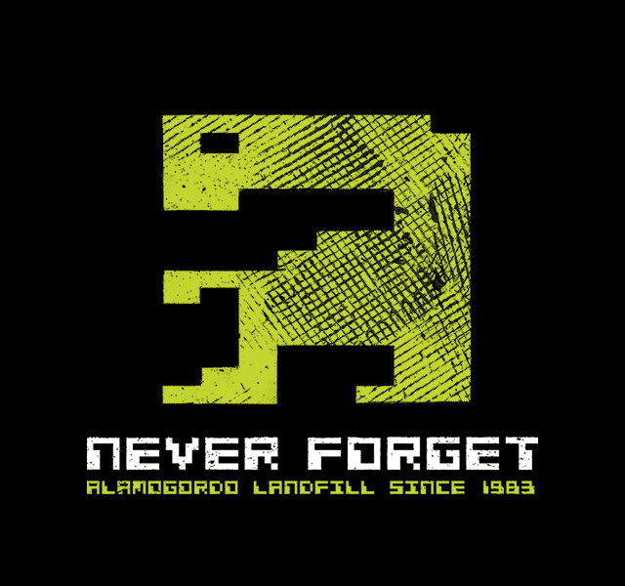
What happened after this?

Slide 18
What happened after this?
Nintendo revived the home console
NES in 1985 (Super Mario Bros!) - strict publishing rules/control
Released Game Boy on their 100th anniversary (1989)
By the early 1990s, SEGA rivaled Nintendo in the home market
SEGA Genesis was the “cool” arcade (SEGA scream)
Led to ESRB ratings
Sony entered the picture with the Playstation in 1995
Casualties: SEGA and Atari (and NEC’s TurboGrafx)

Slide 19
What happened after this?
PC games enjoyed worldwide growth in the 1980s and 1990s
Text games (Zork, King’s Quest)
Interactive graphical games (Day of the Tentacle)
More graphics (Wolfenstein 3D, Doom, Quake, Myst)
Arcades came back in the early 1990s with the release of Street Fighter 2
But died again when consoles like the Sony Playstation started offering the same graphics…..

Slide 20
After 2000?
Microsoft got into the game alongside Sony and Nintendo with the DirectX Box (Xbox)
Portable consoles were popular for some time (the Nintendo 3DS is the only one remaining)
PC gaming went to the Internet & massively multiplayer
Mobile devices exploded….and so did mobile games.

Slide 21
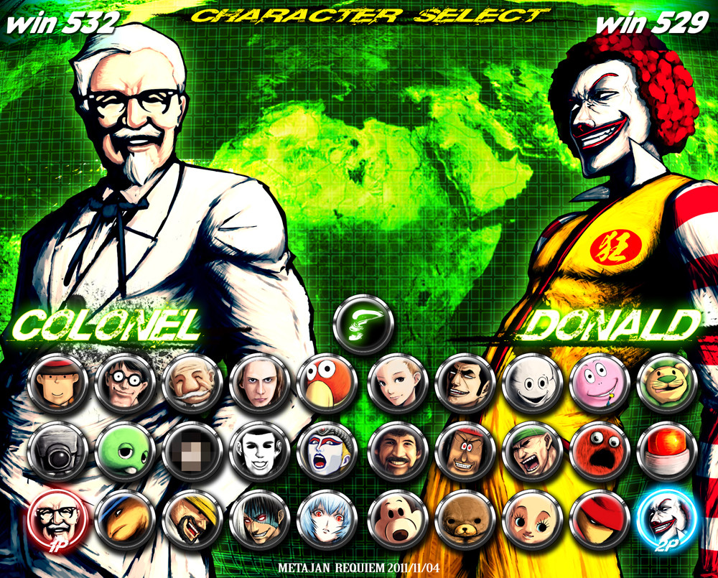

After 2000?
Games are STILL a huge part of pop culture!

Slide 22
Additional Resources
If you’d like to learn more about video game history, below are some recommended books and videos that you can pursue:
Books:
Steven Kent: The Ultimate History of Video Games (2001)
Van Burnham: Supercade: A Visual History of the Videogame Age 1971-1984 (2003)
Demaria & Wilson: High Score! The Illustrated History of Electronic Games (2002)
John Sellers: Arcade Fever: The Fan’s Guide to the Golden Age of Video Games (2001)
Leonard Herman: Phoenix: The Fall & Rise of Video Games (1997)
Goldberg & Vendel: ATARI Inc. - Business Is Fun (2012)
Gorges & Yamazaki: The History of Nintendo (1889-1980) (2010)
Gorges & Yamazaki: The History of Nintendo (1980-1991) (2012)

Slide 23
Additional Resources
Harold Goldberg: All Your Base Are Belong to Us: How Fifty Years of Videogames Conquered Pop Culture (2011)
Videos:
Huffington Post interview with Nolan Bushnell:
http://videos.huffingtonpost.com/nolan-bushnell-517734062
Discovery Channel documentary about video game history:
http://www.youtube.com/watch?v=empni1yCPqw
The Video Game Revolution documentary (very funny and accurate):
http://www.youtube.com/watch?v=jyKb7NOpnvo

Slide 24

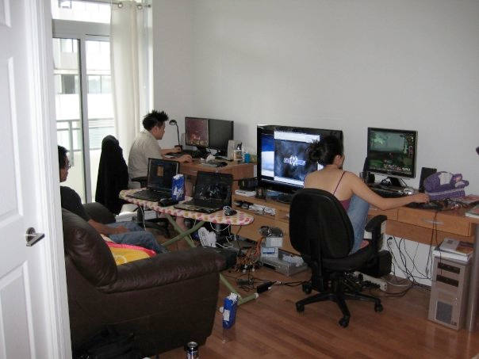

Why Do People Play Games?
Types of Gamers
Casual Gamer
Hardcore Gamer
Old School Gamers
Competitive Gamers
Mental Gamers

Slide 25
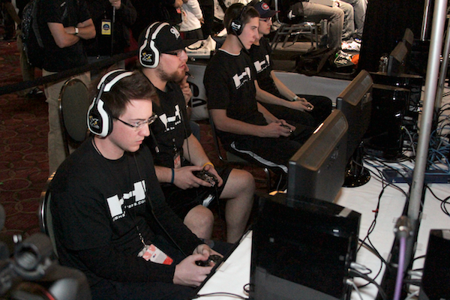
Why Do People Play Games?
Hobby
Procrastinate
Enjoy the game
Escape Reality
To wake up!
To be number 1
To kill time
To make MONEY
Job training

Slide 26
VIDEOS
Watch the 5 minute video The 8-bit Retro Revival – A summary of Jason Eckert’s Sci Fri Talk @ The Ontario Science Centre available on YouTube:
http://www.youtube.com/watch?v=JjC1gn20TR0
Watch the 8 minute PBS documentary The Rise of Competitive Gaming & Esports available on YouTube: https://www.youtube.com/watch?v=GpO76SkpaWQ
These videos are also available within the class files.

Slide 27
Recommended Reading
To learn more about gamification, you can read the book “Reality Is Broken: Why Games Make Us Better and How They Can Change the World” by Jane McGonigal (ISBN: 978-1594202858)

Slide 28
Video Game Genres
Traditional
Sports
Racing
Platformer
Fighter
Puzzle
RTS (Strategy)
RPG
FPS
Action Adventure
Simulation (Life, Pet Raising, Building)
Music
Open World
Party

Slide 29



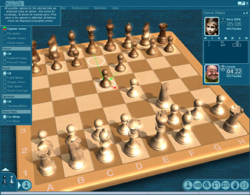
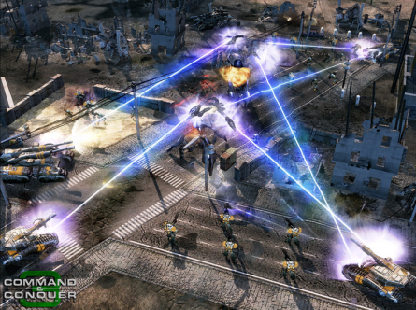
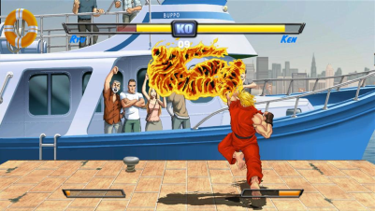

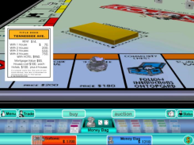
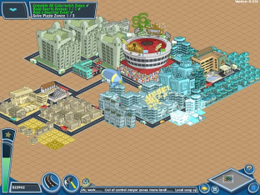

Slide 30

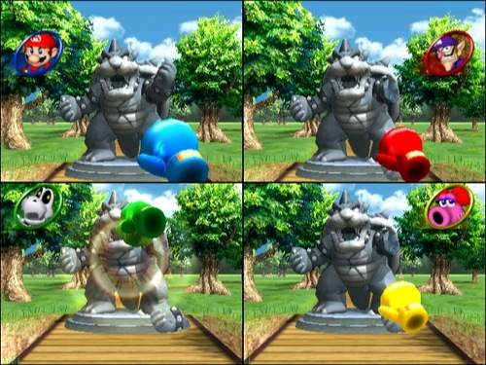



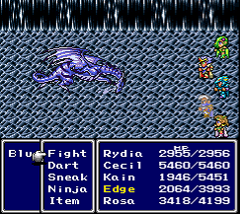


Slide 31
Conclusions
Video/computer games and the people who make them have been around a surprisingly long time
Some companies we know today started with an entirely different focus
Some games makers have done things for sheer challenge, with no thoughts to commercial rewards
Atari set stage for other game companies
Nolan Bushnell, “Father of the Industry,” given too much credit in some ways and not enough in others
Companies make some great business decisions and some really bad ones
Conflict between creative chaos and ordered business within a game company started with Atari
Imitation and outright theft has always been an issue

